Slide 1



Blockchain 101
@FIVIL
https://github.com/fivil
https://www.linkedin.com/in/HammedMohamadi

Slide 2
Abstract
What is Blockchain?
Centralized vs decentralized
Why Decentralization Matters?
Cryptocurrency
Birth of Bitcoin
Applications
Tensions
Structure
Some interesting charts
QUESTIONS?

Slide 3
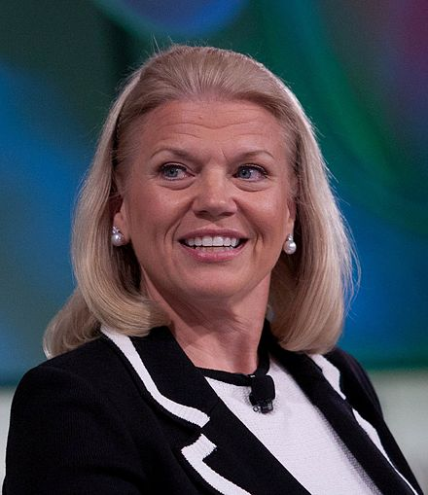

Why should I care?
What the internet did for communications,
I think Blockchain will do for trusted transactions.
IBM Chief Executive Ginny Rometty

Slide 4
What is Blockchain?
Blockchain is a shared, distributed ledger that facilitates the process of recording transactions and tracking assets in a business network. An asset can be tangible — a house, a car, cash, land — or intangible like intellectual property, such as patents, copyrights, or branding. Virtually anything of value can be tracked and traded on a blockchain network, reducing risk and cutting costs for all involved

Slide 5
What is Blockchain?
Blockchain is
Distributed
Ledger
Blockchain is NOT
Bitcoin
Money
P2P
Immutable
Mastercard
A Messenger
A Database

Slide 6
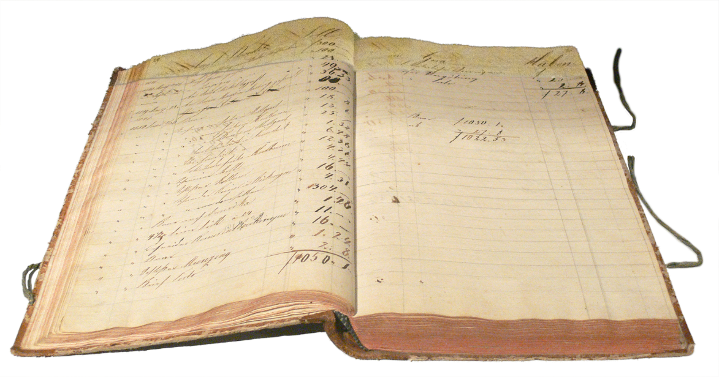
What is Blockchain?
Ledger

Slide 7
Centralized vs decentralized

